Slide 1
“. . . nursing — is expected to see demand rise at least 5% across the country over the next five years, while an estimated 900,000 nurses will leave the profession”
– Healthcare Dive

Slide 2
Technology-Assisted Establishment of a “Reverse Pipeline” Nursing Model
November 6, 2021
Team Members:
Bet Key Wong, Javier Alvarado, Jessica Smith-Amara, Martin Cisneros

Slide 3

No current nursing model exists that brings back retired nurses and those away from bedside to return to flexible and compensated work.

Slide 4
Technology-Assisted New Nurse Model Solution
Drivers in Returning to Clinical Care | New Nurse Model (Gig App) | Casual or Per Diem Nurse | Moonlighting | Travel Nursing Contracts
NOT require full shifts or NOT require night shifts
Ability to negotiate compensation
NOT require certain hours worked per timeframe
Compatible with full time non-nursing or M-F position
Fills the RN staffing gap/ improves nurse burnout
Patient needs met by improved staffing/ completion nursing services
Overall Assessment | 6 | 3 | 4 | 3

Slide 5
Technology-Assisted Model App Prototype

Slide 6
Cost and Scalability
ROI for facilities changing staffing model to accommodate gig work
App subscription-based model for facilities
Increased RN staffing without a burden on nursing education programs
Brings seasoned nurses back to the bedside
Younger generations are naturally gravitating toward the gig economy and nursing is not prepared
Placing value on nursing services may help to champion policy changes around nursing reimbursement models
Realize contribution of nursing to value-based reimbursement

Slide 7

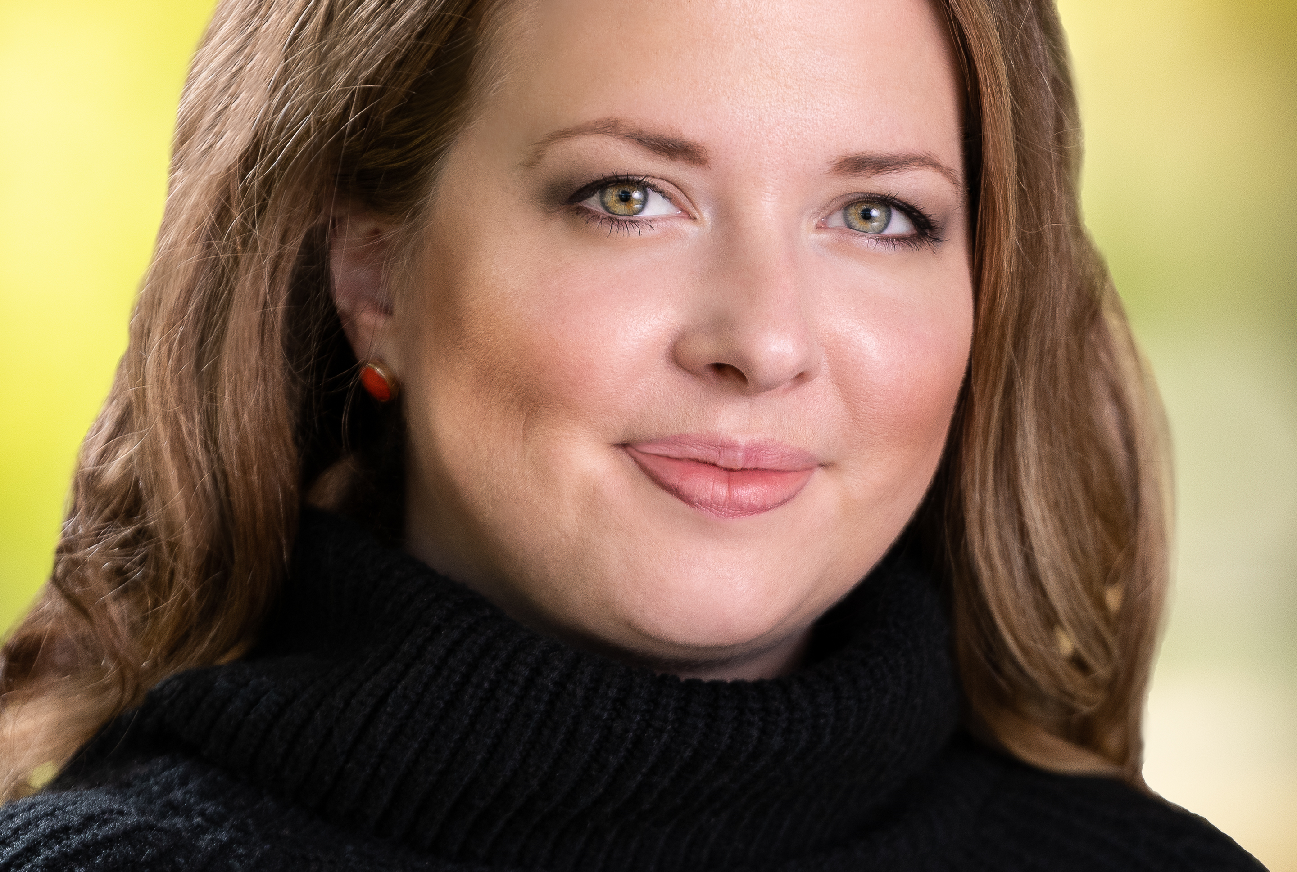

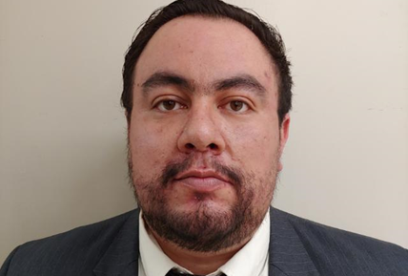
Technology-Assisted “Reverse Pipeline" Team
Bet Key Wong, MSN, RN, CNOR
Jessica Smith-Amara, MSN, RN, NE-BC, CPQH
Javier Alvarado, Data Specialist and Developer
Martin Cisneros

Slide 8
Appendix
From Health Affairs projection study in 2017¹
70,000 RNs will be retiring annually by 2020 (not including data due to pandemic)
Half of the peak in 2002 (from over 1.2 million to 666,000 baby boomer RNs)
By the 2024, over 2 million years lost
A scope review shows ²
Nurse interest in return to work after retirement ranged from 18.3 % in Singapore to 73.2% in Australia
Depending on type of work: flexible, reduced physical demand, and beneficial to self and society (as we see during the pandemic) Research study to determine RP nurse model will bring RNs away from bedside back to this practice setting.

Slide 9
Appendix Sources
1. “How Should We Prepare For The Wave Of Retiring Baby Boomer Nurses?,” Health Affairs Blog, May 3, 2017.DOI: 10.1377/hblog20170503.059894
2. Nurses’ intention to work after retirement, work ability and perceptions after retirement: a scoping review. Pan African Medical Journal. 2019;33:217. doi:10.11604/pamj.2019.33.217.17568

